Slide 1
60 Years of the Western
A quick look at 6 decades of the
Western Neurosurgical Society
A 10 minute talk -- plus time for extended applause

Slide 2
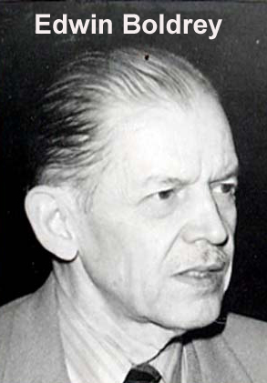
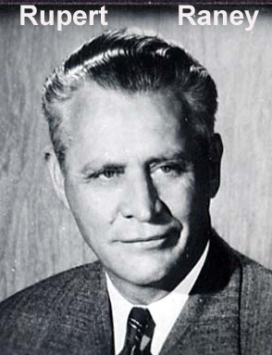
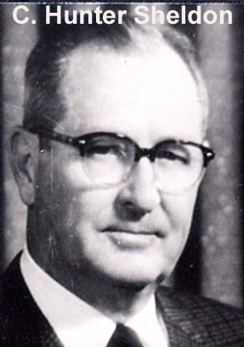
These three men first discussed forming a regional society particularly after noting initial success of the Southern Neurosurgical Society, the first US regional society, formed in 1948. The SF Neurology Society is where CA neurosurgeons would gather and where plans were made for forming the WNS.

Slide 3
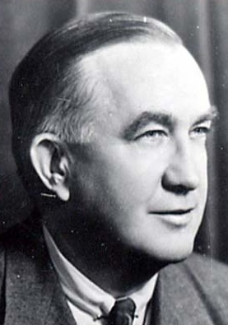
First Annual Meeting November 1955 Santa Barbara Biltmore Hotel
David Reeves 1st President
30 founding members—all neurosurgeons
22 of 30 founders from California—73%
(2014 membership ~ 50% from California)
One full day meeting. Eight presentations. Eleven guests.
1st Banquet – no mention of formal dress

Slide 4
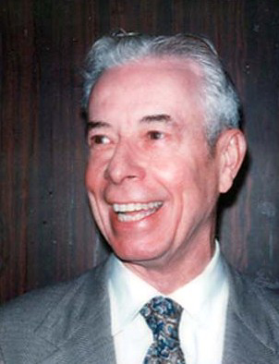
10th Annual Meeting October 1964 San Francisco Fairmont Hotel
Frank Anderson President
68 members
**Description of neurogenic claudication by
Peter Lehman from Vancouver
**Description of Pantopaque cisternography for acoustics by R. L. Scanlon of LA
One full day and 2 half days meeting. 24 papers.
President elect & Historian positions created; tux banquets

Slide 5
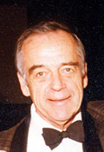
25th Annual Meeting September 1979 Camelback Inn, Scottsdale AZ
Donald Freshwater President
156 members
From 10th to 25th meetings:
1966 First Resident Award paper—Ralph Kamm
1965 First paper on operating microscope--Jannetta
1966 First paper on vascular decompression for tic--Jannetta
1971 First golf tournament
1975 First paper on CT scan; First CME credits

Slide 6
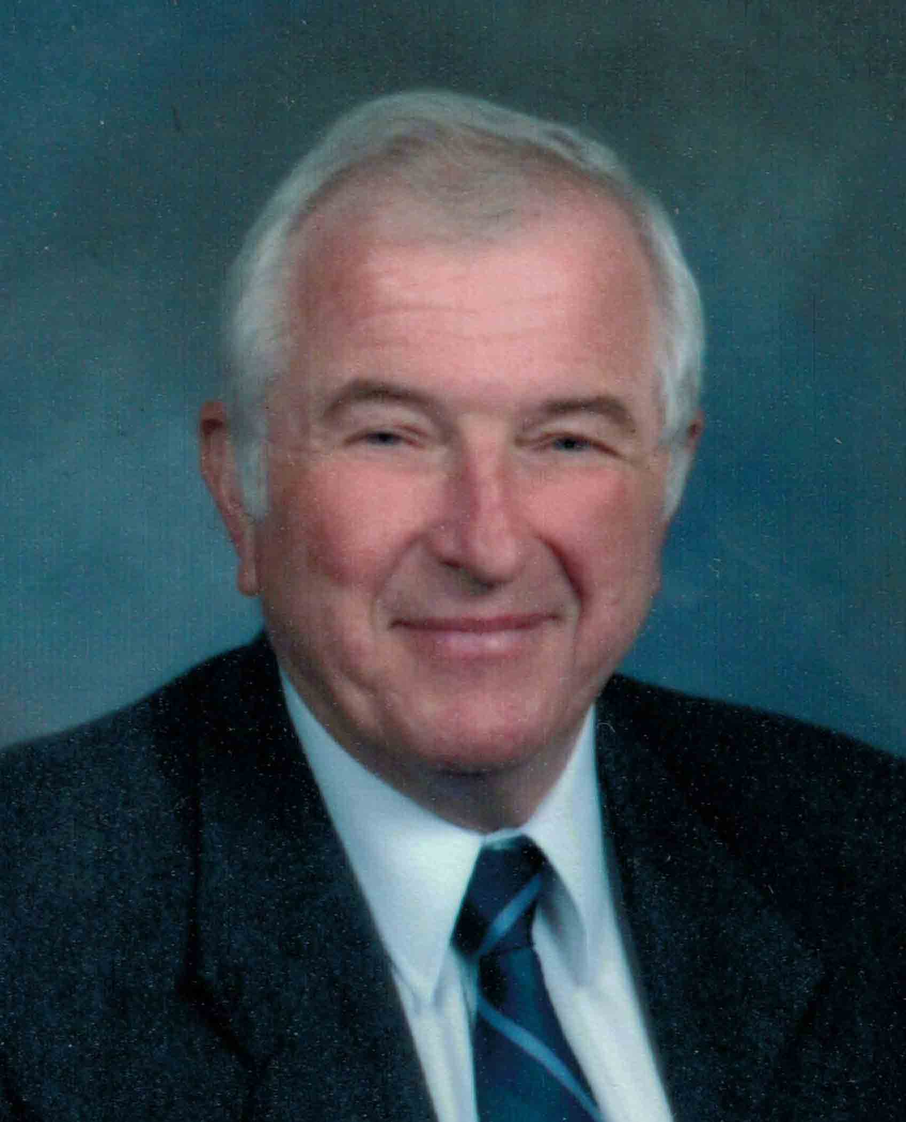
50th Annual Meeting September 2004 Rancho Bernardo Inn, San Diego, CA
Randy Smith President
198 members
From 26th to 50th meetings:
1981—Discontinued Resident Paper Award
1983—First PET scan paper
1984—First MRI paper
1985—First woman member (Fran Conley, Stanford)
1988—First report on shunt anti-siphon device (Foltz)
1991—Active Members 133; highest number in the history of the Society
1997—Society resumes Resident Awards
1999—Ralph Kamm is President (first former resident award winner to become President)

Slide 7
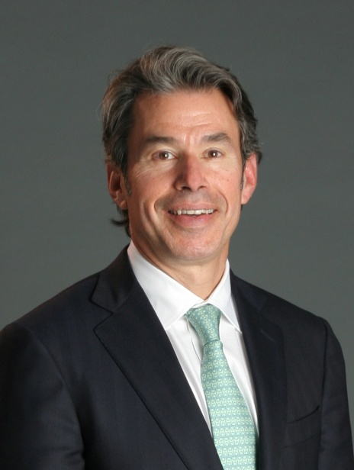
60th Annual Meeting August 2014 Sun Valley Lodge, Sun Valley, ID
Rich Wohns President
207 members
From 50th to 60th meetings:
2006—Society begins two Resident Awards, basic
science and clinical science
2006 Richard Ellenbogen 2nd WNS member to be CNS President
(Bruce Sorensen 1st in 1977)
2013 Bill Couldwell 10th WNS member to be AANS President
2013 Deb Henry becomes 1st woman WNS Secretary-Treasurer

Slide 8
Notable Guests
Joseph P. Evans Chicago 1955
Ronald Melzak Portland 1956
James L. Poppen Boston 1959
Percival Bailey Chicago 1962
Barry M. Goldwater Phoenix 1962
Loyal Davis Chicago 1962
Peter Janetta Pittsburgh 1963
W. Bryan Jennett Glasgow 1966
William Scoville Hartford 1966
Hubert Rosomoff Bronx 1966
Frank H. Mayfield Cincinnati 1971
James L. Poppen Boston 1973
A. Earl Walker Baltimore 1973
C. Miller Fisher Boston 1974
Dwight Parkinson Winnipeg 1979
Kemp Clark Dallas 1980
William Glenn Long Beach 1980
Gilles Bertrand Montreal 1981
Paul L. Kornblith Bethesda 1983
Ludwig M. Auer Graz, Austria 1985
Robert Ojemann Boston 1986
Kenichiro Sugita Nagoya, Japan 1988
Eben Alexander, Jr. Winston-Salem 1989
Guido Guglielmi Los Angeles 1991
Madgid Samii Germany 1997
Donlin Long Baltimore 1998
Victor Fuchs Stanford 1998
Tom Campbell Berkeley 2002

Slide 9
Interesting items
Three men have died in office: President Charles W. Elkins in 1973; President Phil Carter in 2010 and Herb Crockett while President-Elect in 1974 (he was only Secretary/Treasurer not to serve as President).
Don Prolo only member to have been President for 2 years (9/11 cancelled the 2001 meeting) and receive the Cloward Award. He conceived the Cloward Award and the First Lady of the Western pendant.
Of the 38 Resident Award winners only 6 have become WNS members and 3 of the 6 became President (Kamm, Burchiel, Carter).
2014--The year the Society finally cut some slack for members who miss 4 consecutive meetings (adopted Debbie Henry’s idea of an Inactive membership category).
Rich Wohns first President to hold MD, MBA, JD degrees

Slide 10
The Western
Still Strong
Still Relevant
Still your Society

